Slide 1
Sampling Based Inference
Il-Chul Moon
Dept. of Industrial and Systems Engineering
KAIST
icmoon@kaist.ac.kr

Slide 2
Weekly Objectives
Learn basic sampling methods
  Understand the concept of Markov chain Monte Carlo
  Able to apply MCMC to the parameter inference of Bayesian networks
  Know the mechanism of rejection sampling
  Know the mechanism of importance sampling
Learn sampling based inference
  Understand the concept of Metropolis-Hastings algorithm
  Know the mechanism of Gibbs sampling
Know a case study of sampling based inference
  Understand the latent Dirichlet allocation model
  Know the collapsed Gibbs sampling
  Know how to derive Gibbs sampling formula for LDA

Slide 3
Basic Sampling methods

Slide 4
Forward Sampling
Generate a sample from the Bayesian network
  Follow topological order
    Buglary → false
    Earthquake → false
    Alarm|B=F,E=F→true
    JC|A=T→true
    MC|A=T→false
  Create such sample many, many, many times
Then, count the samples match the case
  P(E=T|MC=T)=?
    Count the cases of E=T and MC=T
    Count the cases of MC=T
Any problem?
P(B)=0.001
P(E)=0.002
Buglary
Earthquake
Alarm
JohnCalls
MaryCalls
A | P(J|A)
T | 0.90
F | 0.05
B | E | P(A|B,E)
T | T | 0.95
T | F | 0.94
F | T | 0.29
F | F | 0.001
A | P(M|A)
T | 0.70
F | 0.01

Slide 5


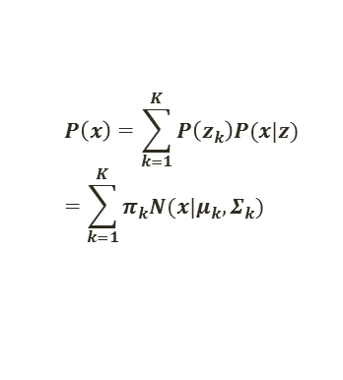


Forward Sampling in GMM
$$P\left(x\right)=\sum_{k=1}^{K}{P\left(z_{k}\right)P(x|z) }=\sum_{k=1}^{K}{π_{k}N(x|μ_{k},Σ_{k})}$$
Forward sampling of GMM
  Sample z from $π$
    z is the indicator of the mixture distribution
  With selected z, sample x from $N(μ_{z},Σ_{z})$
After many, many sampling, you can draw the
histogram of the mixture distribution
  You have an empirical PDF, so you can ask a
  query like $P(0≤x≤\text{5|}π,μ,Σ)$
$$π$$
z
$$μ$$
$$Σ$$
x
N

Slide 6
Rejection Sampling
P(E=T|MC=T,A=F)=?
RejectionSampling
  Iterate many times
    Generate a sample from the Bayesian network
      Buglary → false
      Earthquake → true
      Alarm|B=F,E=T→true
        If the sample does not follow MC=T, A=F, reject the sampling procedure, and repeat
      JC|A=T→true
      MC|A=T→false
  Return Count(E=T,MC=T,A=F)/# of Samples
Any problem?
P(B)=0.001
P(E)=0.002
Buglary
Earthquake
Alarm
JohnCalls
MaryCalls
A | P(J|A)
T | 0.90
F | 0.05
B | E | P(A|B,E)
T | T | 0.95
T | F | 0.94
F | T | 0.29
F | F | 0.001
A | P(M|A)
T | 0.70
F | 0.01

Slide 7

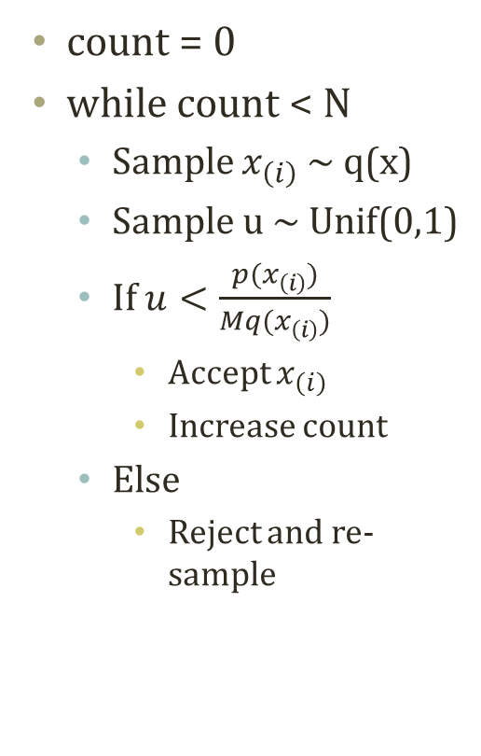



Rejection Sampling from Numerical View
Distribution that is easy to sample
Should be an envelope of p(x) by adjusting M
count = 0
while count < N
  Sample $x_{\left(i\right)}$ ~ q(x)
  Sample u ~ Unif(0,1)
  If $u<\frac{p(x_{\left(i\right)})}{Mq(x_{\left(i\right)})}$
    Accept $x_{\left(i\right)}$
    Increase count
  Else
    Reject and re-sample
p(x), q(x)
$$\text{Mq}\text{(}x_{\left(i\right)})$$
Reject Region
$$p(x_{\left(i\right)})$$
Distribution that is difficult to sample
$$\text{uMq}\text{(}x_{\left(i\right)})$$
p(x)
Accept Region
q(x)
  $x_{\left(i\right)}$ ~ q(x)
x

Slide 8
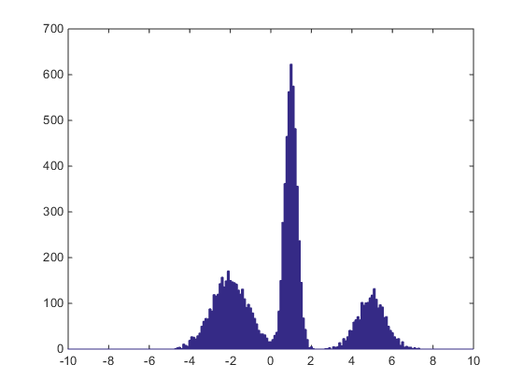
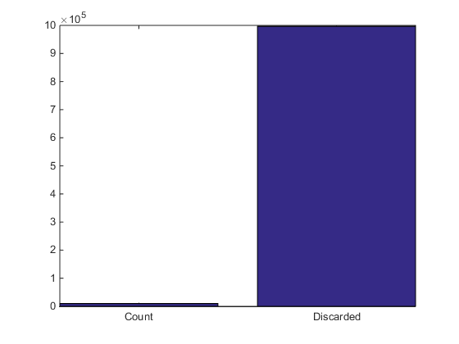
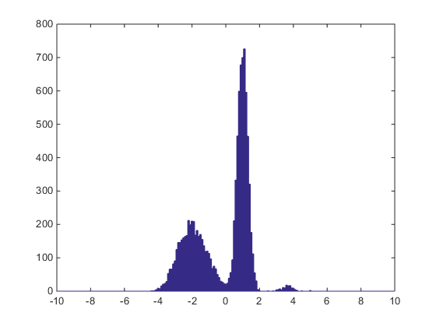
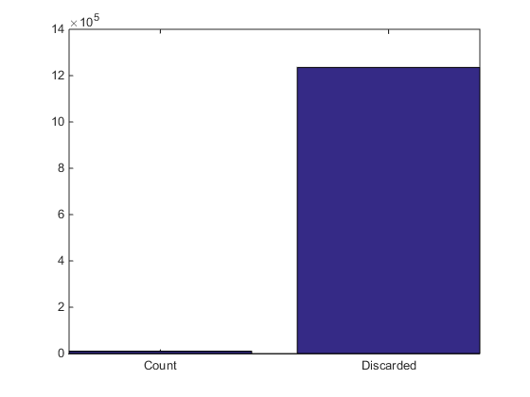

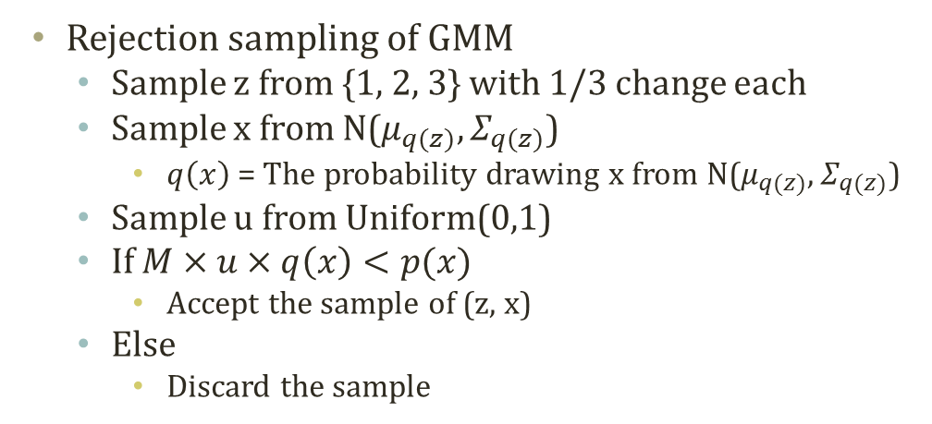


Rejection Sampling in GMM
$$P\left(x\right)=\sum_{k=1}^{K}{P\left(z_{k}\right)P(x|z) }=\sum_{k=1}^{K}{π_{k}N(x|μ_{k},Σ_{k})}$$
$$π$$
Rejection sampling of GMM
  Sample z from {1, 2, 3} with 1/3 change each
  Sample x from N($μ_{q(z)},Σ_{q(z)}$)
    $q\left(x\right)$ = The probability drawing x from N($μ_{q(z)},Σ_{q(z)}$)
  Sample u from Uniform(0,1)
  If $M×u×q\left(x\right)<p(x)$
    Accept the sample of (z, x)
  Else
    Discard the sample
z
$$μ$$
$$Σ$$
x
N
P Mixture
= 0.35*N(-2,0.9),
0.45*N(1,0.3),
0.2*N(5,0.8)
Q Mixture
= 1/3*N(-2,1), 1/3*N(1,1), 1/3*N(5,1)
Q Mixture
= 3 * ( 1/3 * N(0,1) )

Slide 9
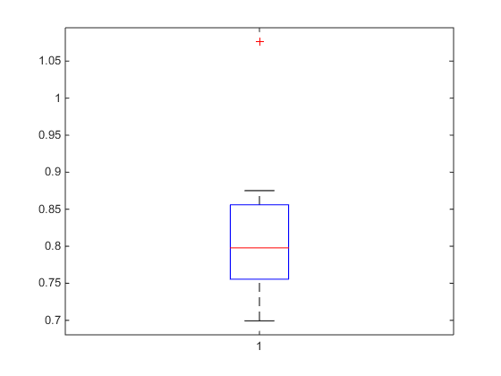
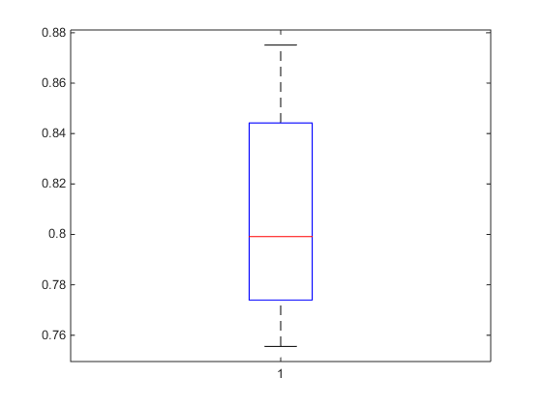
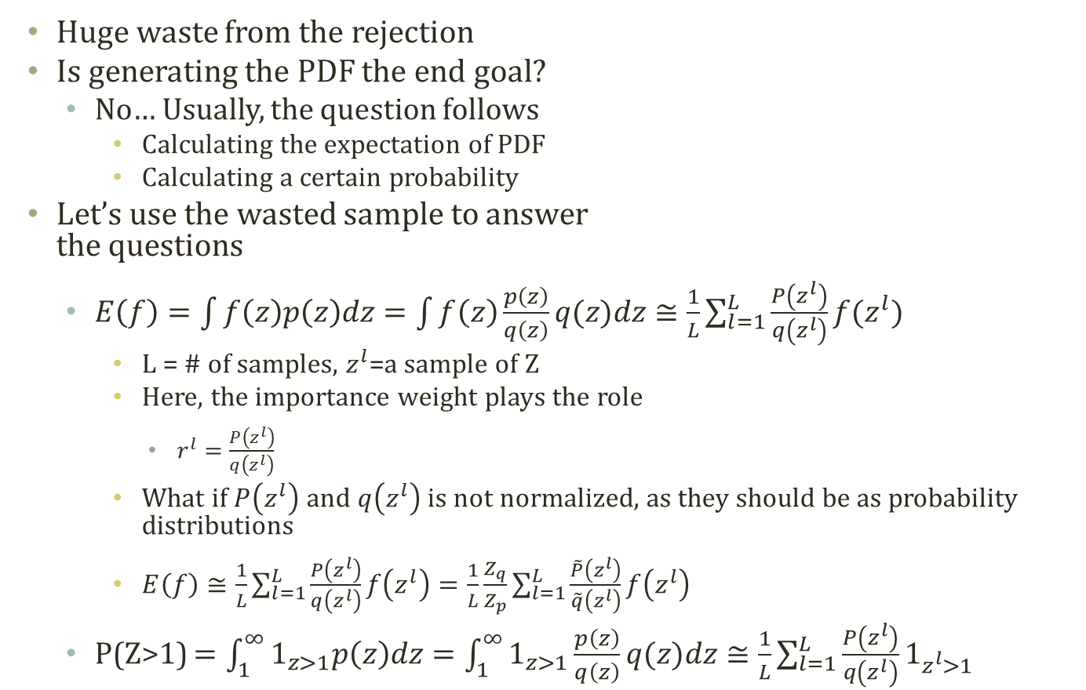
Importance Sampling
Importance
Sampling
Prone to
Extreme
Values
Huge waste from the rejection
Is generating the PDF the end goal?
  No… Usually, the question follows
    Calculating the expectation of PDF
    Calculating a certain probability
Let’s use the wasted sample to answer
the questions
  $E\left(f\right)=\int{f\left(z\right)p\left(z\right)dz}=\int{f\left(z\right)\frac{p\left(z\right)}{q\left(z\right)}q(z)dz}≅\frac{1}{L}\sum_{l=1}^{L}{\frac{P\left(z^{l}\right)}{q\left(z^{l}\right)}f(z^{l})}$
    L = # of samples, $z^{l}$=a sample of Z
    Here, the importance weight plays the role
      $r^{l}=\frac{P\left(z^{l}\right)}{q\left(z^{l}\right)}$
    What if $P\left(z^{l}\right)$ and $q\left(z^{l}\right)$ is not normalized, as they should be as probability distributions
    $E\left(f\right)≅\frac{1}{L}\sum_{l=1}^{L}{\frac{P\left(z^{l}\right)}{q\left(z^{l}\right)}f\left(z^{l}\right)}=\frac{1}{L}\frac{Z_{q}}{Z_{p}}\sum_{l=1}^{L}{\frac{\tilde{P}\left(z^{l}\right)}{\tilde{q}\left(z^{l}\right)}f\left(z^{l}\right)}$
  P(Z>1) $=\int_{1}^{∞}{1_{z>1}p\left(z\right)dz}=\int_{1}^{∞}{1_{z>1}\frac{p\left(z\right)}{q\left(z\right)}q(z)dz}≅\frac{1}{L}\sum_{l=1}^{L}{\frac{P\left(z^{l}\right)}{q\left(z^{l}\right)}1_{z^{l}>1}}$
Filtered
Extreme
Values

Slide 10
Likelihood Weighting Algorithm
P(E=T|MC=T,A=F)=?
LikelihoodWeighting
  SumSW=NormSW=0
  Iterate many times
    SW=SampleWeight = 1
    Generate a sample from the Bayesian network
      Buglary → false
      Earthquake → false
      Alarm=F|B=F,E=F
        P(A=F|B=F,E=F)=0.999
        SW=1*0.999
      JC|A=T→true
      MC=T|A=F
        P(MC=T|A=F)=0.01
        SW=1*0.999*0.01
    If the sample has E=T, then SumSW+=SW
    NormSW+=SW
  Return SumSW/NormSW
Any further improvement?
These samples are….
P(B)=0.001
P(E)=0.002
Buglary
Earthquake
Alarm
JohnCalls
MaryCalls
A | P(J|A)
T | 0.90
F | 0.05
B | E | P(A|B,E)
T | T | 0.95
T | F | 0.94
F | T | 0.29
F | F | 0.001
A | P(M|A)
T | 0.70
F | 0.01

